Slide 1

CSE (H) with specialization in Machine Learning and Artificial Intelligence
Soft Computing
Chapter -2.3
By: Dr. Monika Singh E11032
DISCOVER . LEARN . EMPOWER

Slide 2
Course Objectives
To introduce soft computing concepts and techniques of artificial neural networks, fuzzy sets, fuzzy logic and genetic algorithms
To understand the various techniques from the application point of view.
To analyze various soft computing techniques and decide the technique to be used in a particular problem situation.
To implement soft computing based solutions for real-world problems

Slide 3
Course Outcomes
CO1 | Identify and describe soft computing techniques and their roles in building intelligent. Machines | 1
CO2 | Recognize the feasibility of applying a soft computing methodology for a particular problem. | 2,4
CO3 | Apply fuzzy logic and reasoning to handle uncertainty and solve engineering problems, genetic algorithms to combinatorial optimization problems and neural networks to pattern classification and regression problems. | 3
CO4 | Effectively use modern software tools to solve real problems using a soft computing approach. | 3
CO5 | Evaluate various soft computing approaches for a given problem. | 4

Slide 4
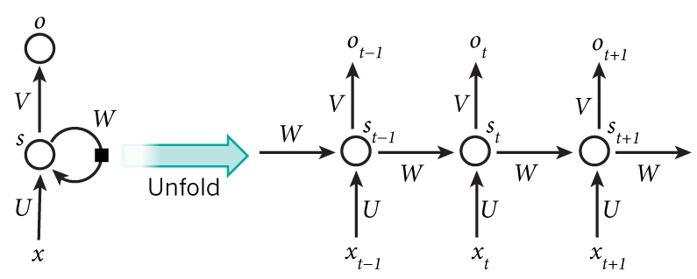
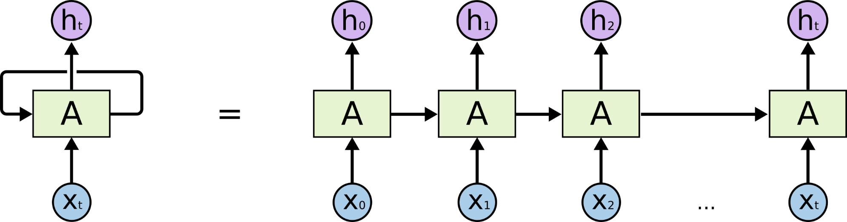
Recurrent Neural Network

Slide 5
How does RNN reduce complexity?
Given function f: h’,y=f(h,x)
h and h’ are vectors with the same dimension
y¹
y²
y³
h⁰
f
h¹
f
h²
f
h³
……
x¹
x²
x³
No matter how long the input/output sequence is, we only need one function f. If f’s are different, then it becomes a feedforward NN. This may be treated as another compression from fully connected network.

Slide 6

Deep RNN
h’,y = f₁(h,x), g’,z = f₂(g,y)
…
…
…
z¹
z²
z³
g⁰
f₂
g¹
f₂
g²
f₂
g³
……
y¹
y²
y³
h⁰
f₁
h¹
f₁
h²
f₁
h³
……
x¹
x²
x³

Slide 7
Bidirectional RNN
y,h=f₁(x,h)
z,g = f₂(g,x)
x¹
x²
x³
g⁰
f₂
g¹
f₂
g²
f₂
g³
z¹
z²
z³
p¹
p²
p³
p=f₃(y,z)
f₃
f₃
f₃
y¹
y²
y³
h⁰
f₁
h¹
f₁
h²
f₁
h³
x¹
x²
x³

Slide 8
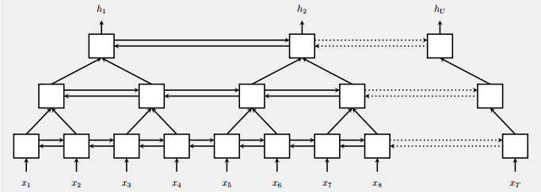
Pyramid RNN
Significantly speed up training
Reducing the number of time steps
Bidirectional
RNN
W. Chan, N. Jaitly, Q. Le and O. Vinyals, “Listen, attend and spell: A neural network for large vocabulary conversational speech recognition,” ICASSP, 2016

Slide 9
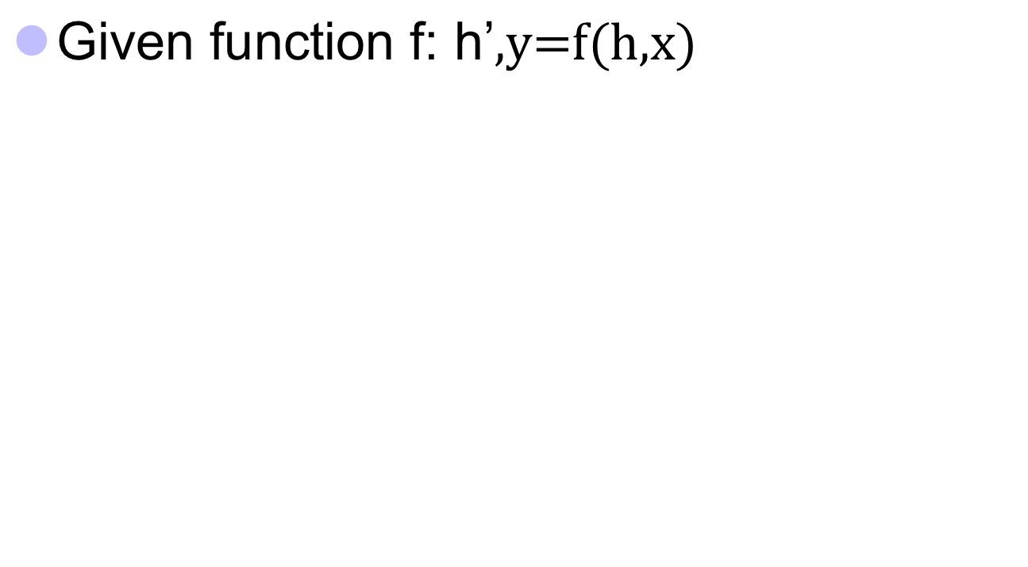



Naïve RNN
y
h'
W^{h}
^{h}
W^{i}
x
h
f
h'
y
Wº
^{h’}
Note, y is computed
from h’
x
softmax
We have ignored the bias

Slide 10
Problems with naive RNN
When dealing with a time series, it tends to forget old information. When there is a distant relationship of unknown length, we wish to have a “memory” to it.
Vanishing gradient problem.

Slide 11
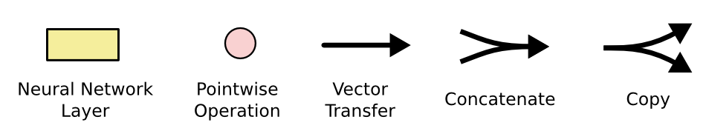
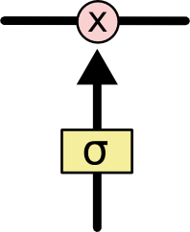
The sigmoid layer outputs numbers between 0-1 determine how much
each component should be let through. Pink X gate is point-wise multiplication.

Slide 12
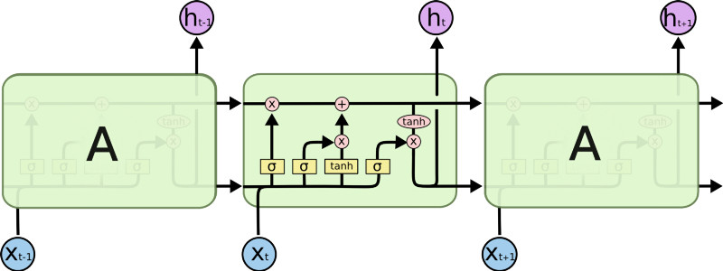
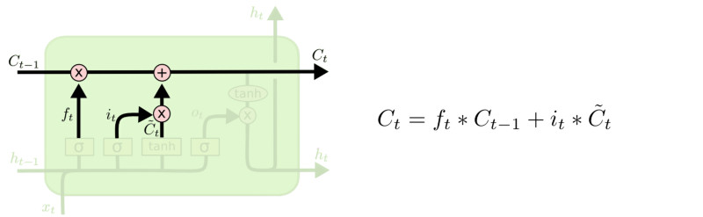
LSTM
Output gate
Controls what
goes into output
This sigmoid gate
determines how much
information goes thru
This decides what info
Is to add to the cell state
C_{t-1}
h_{t-1}
Forget input
gate gate
The core idea is this cell state C_{t}, it is changed slowly, with only minor linear interactions. It is very easy for information to flow along it unchanged.
Why sigmoid or tanh:
Sigmoid: 0,1 gating as switch.
Vanishing gradient problem in
LSTM is handled already.
ReLU replaces tanh ok?

Slide 13
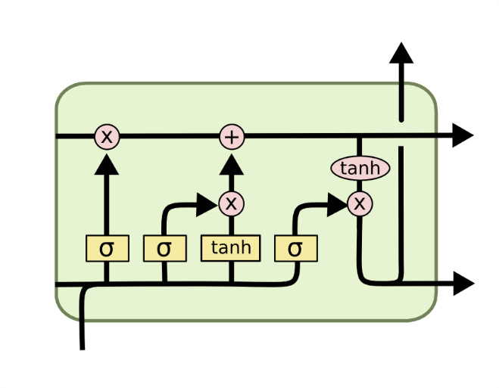
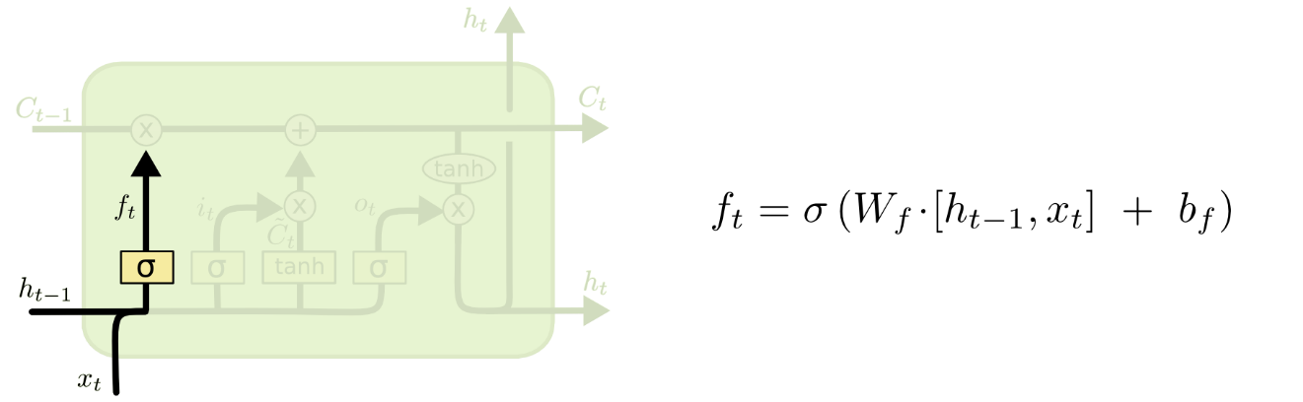
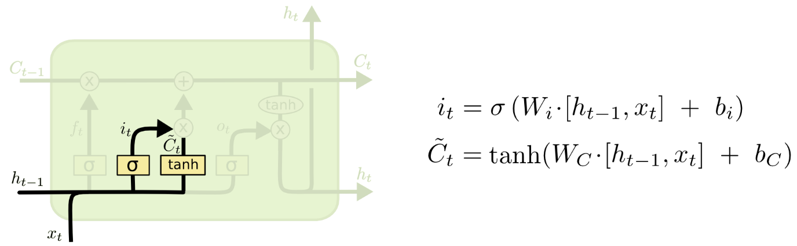
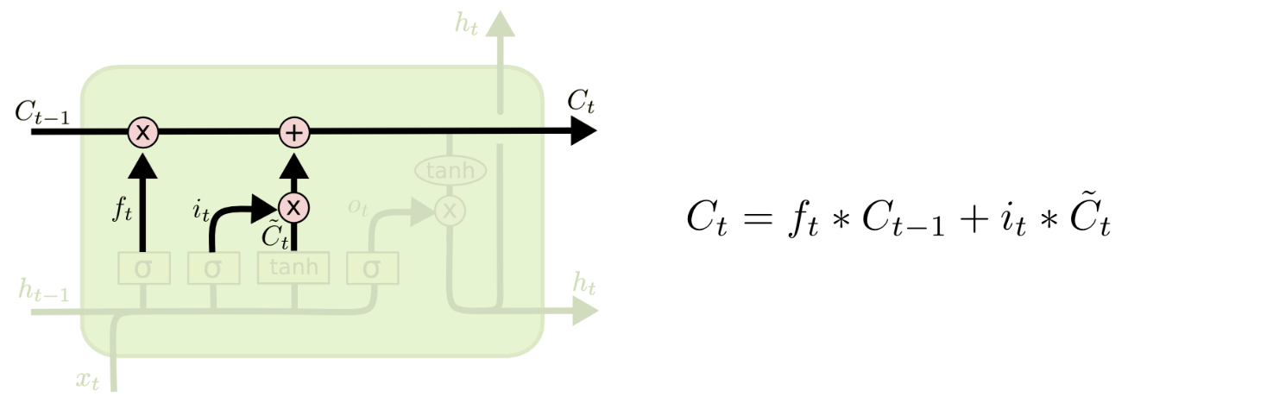
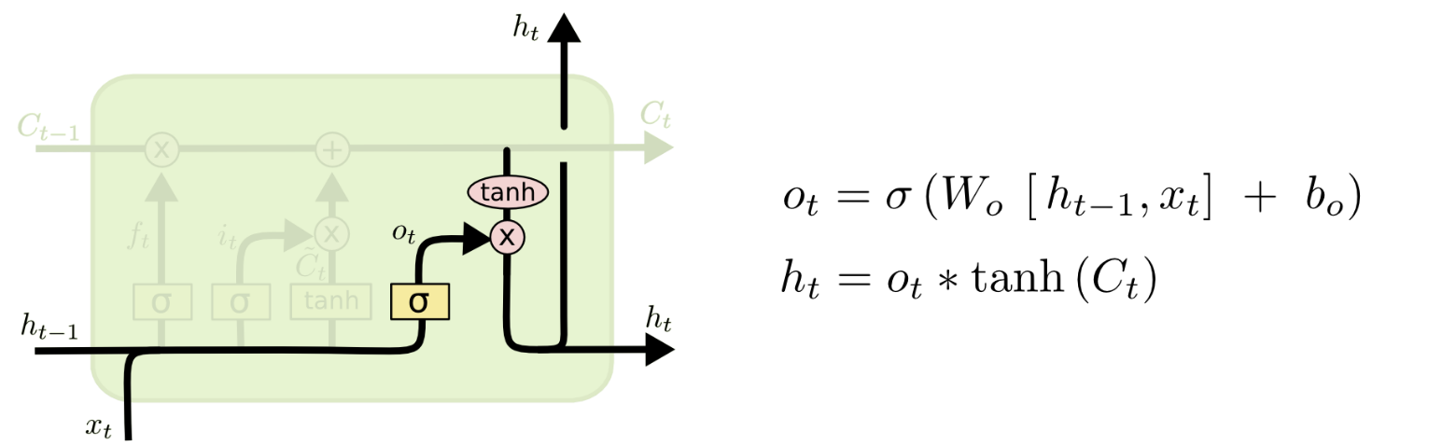
i_{t} decides what component
is to be updated.
C’_{t} provides change contents
Updating the cell state
Decide what part of the cell
state to output

Slide 14
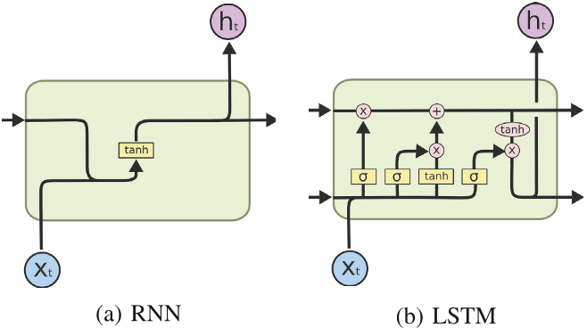
RNN vs LSTM

Slide 15
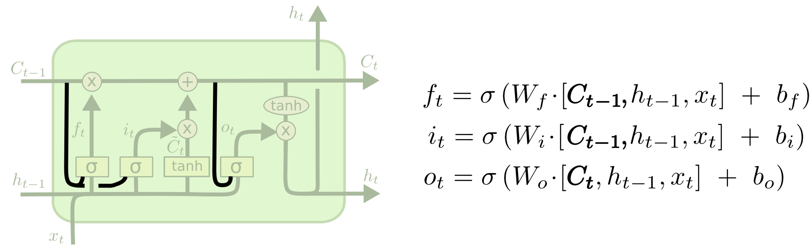
Peephole LSTM
Allows “peeping into the memory”

Slide 16
Naïve RNN vs LSTM
y^{t}
LSTM
c^{t}
y^{t}
c^{t-1}
Naïve
RNN
h^{t}
h^{t}
h^{t-1}
h^{t-1}
x^{t}
x^{t}
c changes slowly
c^{t} is c^{t-1} added by something
h changes faster
h^{t} and h^{t-1} can be very different

Slide 17
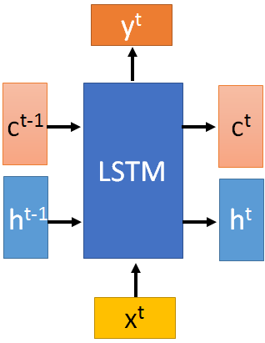

These 4 matrix
computation should
be done concurrently.
x^{t}
z
W
h^{t-1}
c^{t-1}
x^{t}
z^{i}
W^{i}
= σ( )
h^{t-1}
Controls
forget gate
Controls
input gate
Updating
information
Controls
Output gate
W^{f}
x^{t}
z^{f}
= σ( )
h^{t-1}
z^{f}
z^{i}
z
zº
x^{t}
zº
Wº
= σ( )
h^{t-1}
x^{t}
h^{t-1}
Information flow of LSTM

Slide 18
x^{t}
z
W
h^{t-1}
=tanh( )
c^{t-1}
c^{t-1}
diagonal
“peephole”
zº
z^{f}
z^{i}
obtained by the same way
z^{f}
z^{i}
z
zº
h^{t-1}
x^{t}
Information flow of LSTM

Slide 19




Element-wise multiply
y^{t}
c^{t-1}
c^{t}
c^{t} = z^{f}  c^{t-1} + z^{i}z
tanh
h^{t} = zº  tanh(c^{t})
y^{t} = σ(W’ h^{t})
z^{f}
z^{i}
z
zº
h^{t-1}
x^{t}
h^{t}
Information flow of LSTM

Slide 20



LSTM information flow
y^{t}
y^{t+1}
c^{t-1}
c^{t}
c^{t+1}
tanh
tanh
z^{f}
z^{i}
z
zº
z^{f}
z^{i}
z
zº
h^{t+1}
h^{t-1}
x^{t}
h^{t}
x^{t+1}
Information flow of LSTM

Slide 21
References
“Principles of Soft Computing, 2nd Edition” by S.N. Sivanandam & SN Deepa, Wiley India Pvt. Ltd.
Link :
https://analyticsindiamag.com/6-types-of-artificial-neural-networks-currently-being-used-in-todays-technology/

Slide 22
THANK YOU
For queries
Email: monika.e11032@cumail.in

